Slide 1
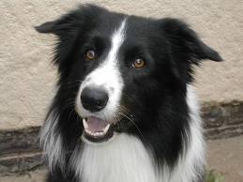
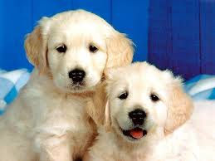
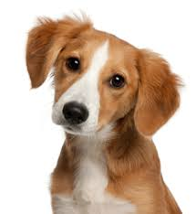
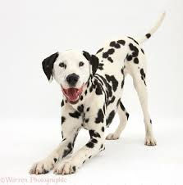
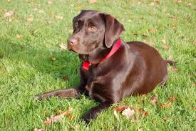
Dogs By Charlotte

Slide 2
Contents Page
Types of dogs – pg 1
What do dogs eat and drink? – pg 2
Exercise – pg 3
Dogs with jobs – pg 4
My dogs – pg 5

Slide 3
Types of dogs
There are lots of types of dogs.
Some of them are…
labrador – different colours
dalmation
husky
golden retriever
border collie
1

Slide 4
What do dogs eat and drink?
Dogs can eat meals and treats.
Meals can be dry food or tinned wet food.
Treats can be dog biscuits or Denta Stix (which are good for their teeth).
Some dogs might have leftovers from human food.
Dogs drink water.
2

Slide 5
Exercise
Dogs need lots of exercise.
Dogs like to go for walks.
They like to run with people.
Fetching balls and other toys is fun for dogs and their owners.
3

Slide 6
Dogs with jobs
Guide dogs help people who cannot see. They help them to walk safely.
Police use dogs to smell things for them, as they can smell lots.
Sheep dogs round up sheep for farmers.
Sled dogs pull slegdes for people.
4

Slide 7
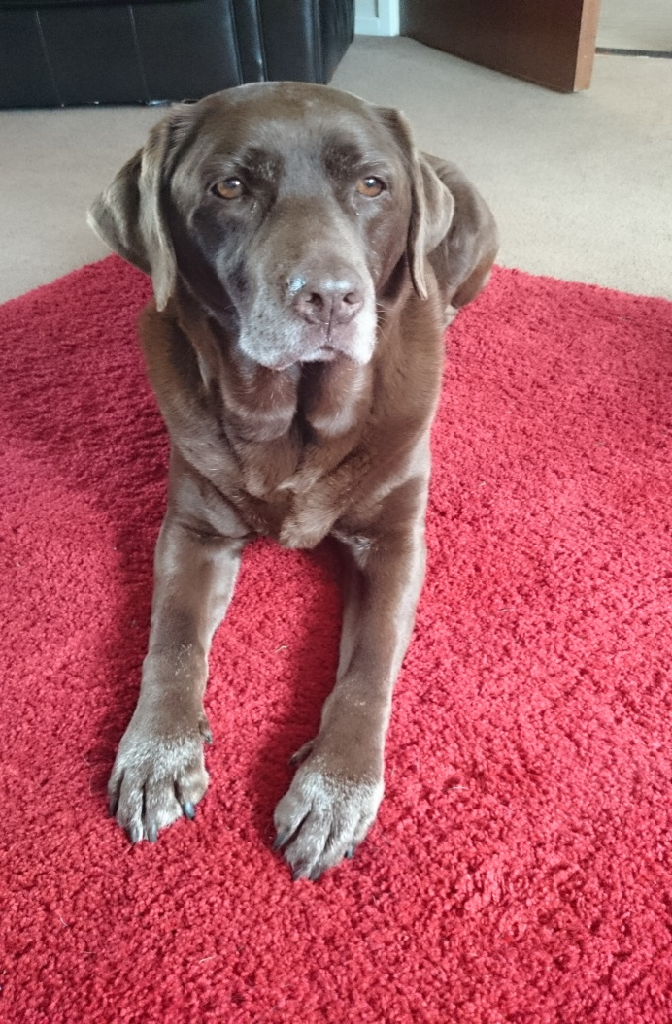
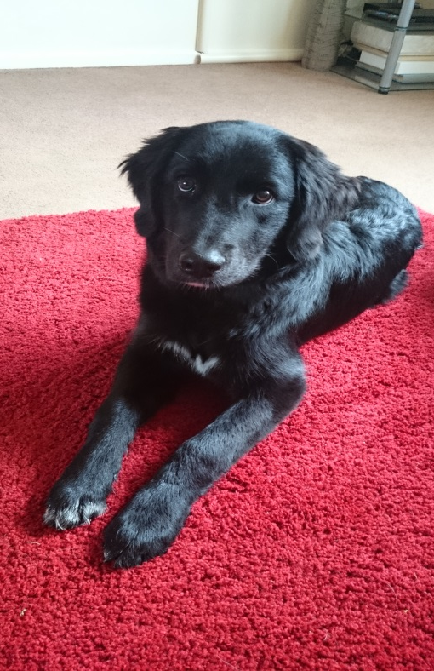
My dogs
I have a chocolate labrador called Molly who is 10 and a retriever collie cross called Murphy who is 7 months old.
I love my dogs very much!
5

